Slide 1
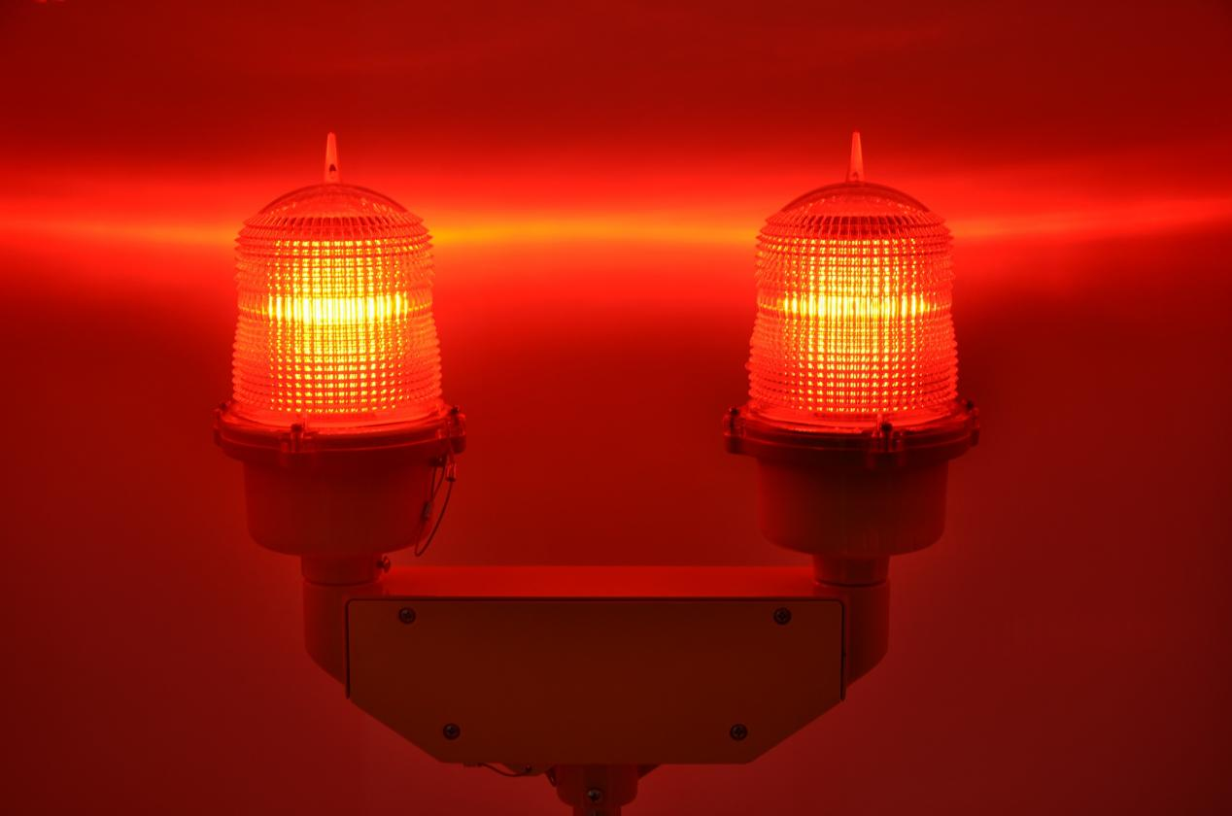
Sensation Park
Employee Safety Training

Slide 2
Our Top Priority
At Sensation Park, guest and employee safety is our top priority. Staff must report all accidents, no matter how minor, so that trained safety and security personnel can document and officially report incidents.

Slide 3
Injury Prevention—Protect Guests
Complete scheduled equipment checks
Enforce boarding restrictions for all rides
Verify height requirements for young children
Check every seatbelt and harness
Assist guests to understand regulations
Refer questions to your supervisor
STOP
If Safety is Questionable

Slide 4
Summer Season
Implementation of new safety guidelines
Installation of new signage throughout the parks
Ride entrances
Visitor center
Rest areas
Completion of staff training in new safety guidelines and basic first aid training

Slide 5

Prevent Heatstroke During the Hot Summer Season
Be sure to stay well hydrated and always choose water over soda or juice. Apply sunscreen and wear your uniform hat or visor.

Slide 6
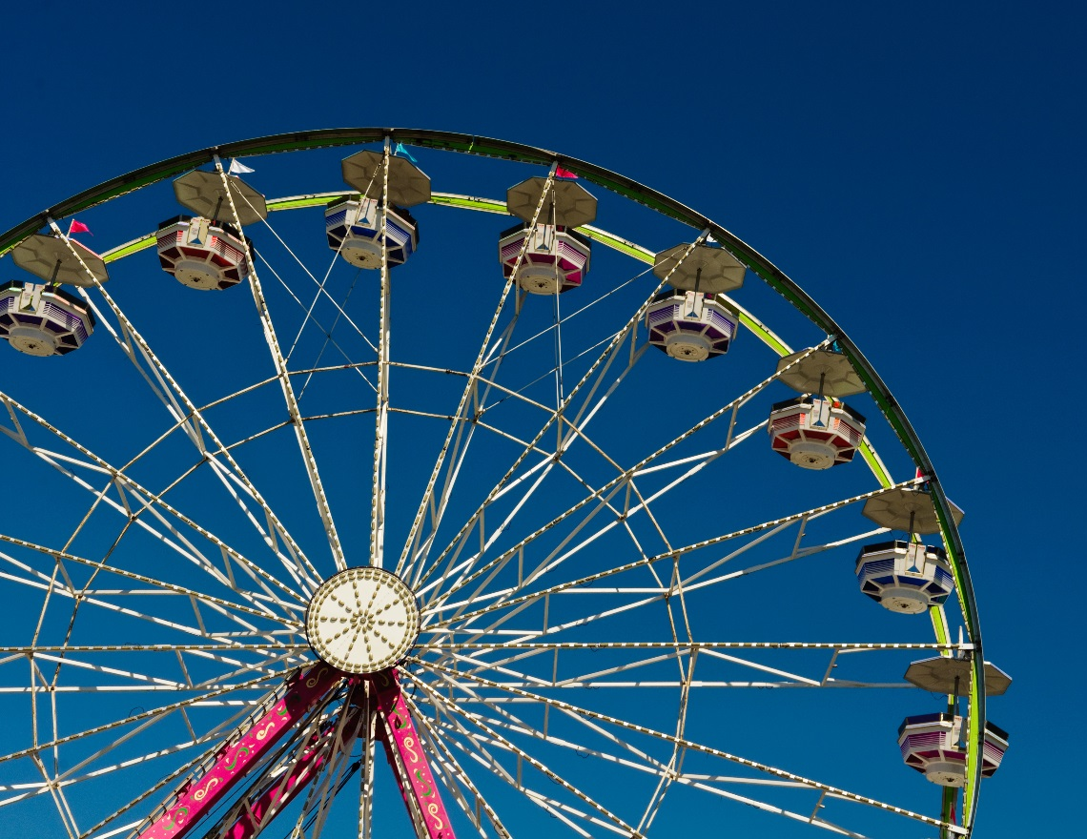
At Sensation Park
Safety Is Our Top Priority

